Slide 1
Reinforcement Learning in Robotics
Hunter Damron

Slide 2
Outline
Introduction
Common learning problems in robotics
Reinforcement learning in general
Emergence Paper
Overview of contribution
Details
Motor babbling papers
Relation to humans
Possible goals
Pros/Cons
Details
Self-modeling papers
Difference from emergence paper
Details

Slide 3
Overview
Introduction to reinforcement learning
Discussion of “Emergence of Locomotion Behaviours in Rich Environments” by DeepMind
Similar applications of machine learning to robotic planning and control

Slide 4
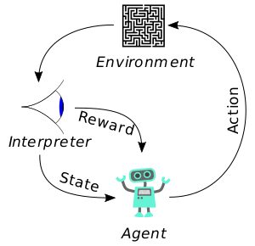
Overview of Reinforcement Learning
Problem statement: an agent learns how to interact with its environment to maximize some reward
Agent observes its environment and reacts accordingly
Agent has no initial knowledge of its environment or how how to react to stimuli

Slide 5
Reinforcement Learning in Nature
Examples
Animal learning to walk shortly after being born maximizes reward of food, water, and safety
Society learning to communicate and work together maximizes reward for the average individual
Nature is extremely good at learning

Slide 6
Successes with Reinforcement Learning
Board games
Backgammon – TD-Gammon
Go – AlphaGo
Video games
Various Atari games
Robotics
Walking (the primary paper discussed in this presentation)
Dexterity problems

Slide 7

Notes:
Emergence of Locomotion Behaviours in Rich Environments

Slide 8
Technique in “Emergence of Locomotion”
Distributed Proximal Policy Optimization
Agent makes decisions based on a policy which determines actions based on inputs
Cycles between running a policy to collect data about its current reward and optimizing the policy with respect to that reward
Uses recurrent neural network to allow time dependent decisions
Distributed data collection and gradient calculation among multiple agents simultaneously for scalability
Reward is based on forward velocity and not falling
Also penalizes torques to prevent falling earlier

Slide 9
Technique in “Emergence of Locomotion”
Environments
Varying obstacle courses
Obstacles get gradually harder within an environment
Procedurally generated
Observation
Acceleration, velocity, and gyroscope
Contact sensors
Sampled height of nearby terrain

Slide 10
Why this paper is a big deal
Sophisticated, high dimensionality behavior arises as a result of a simple reward function
This behavior is robust enough to perform well in unseen environments
Training on diverse environments allows the generalized skill to be learned rather than overfitting a policy

Slide 11
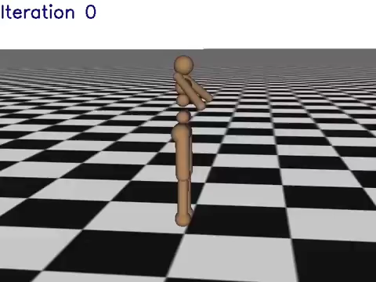

Slide 12
Motor Babbling
Before task is assigned motors are allowed to move randomly, allowing the system to gain a preliminary map of its control inputs to movements
Often used for self-modeling
Natural example:
Babies make seemingly random noises and movements

Slide 13
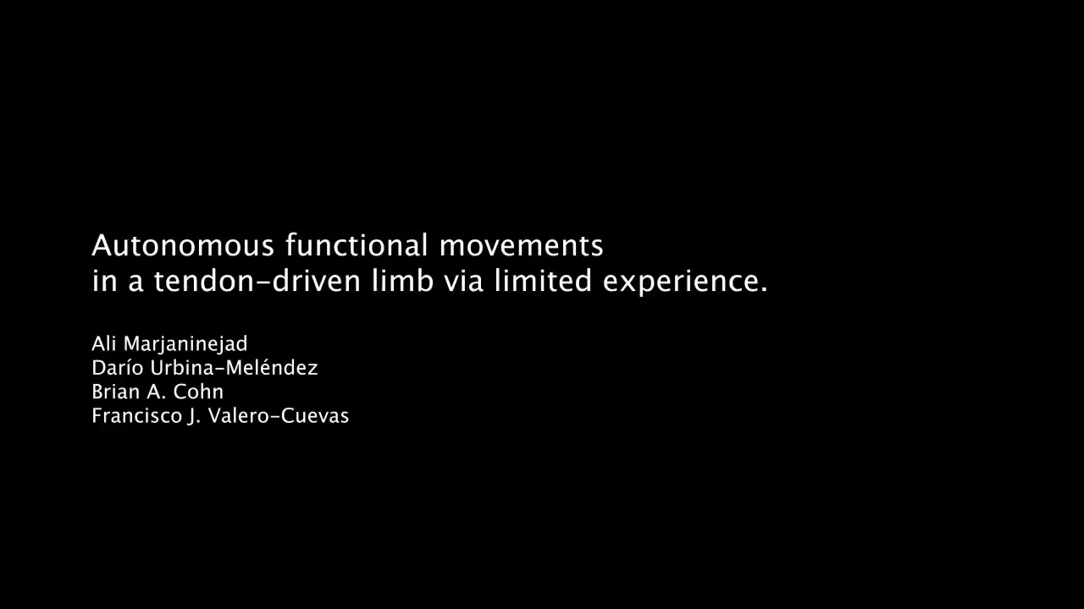
Notes:
Autonomous functional movements in a tendon-driven limb via limited experience

Slide 14
Self-Modeling
Intermediate stage for learning
Robot learns its own physical model then uses that model to perform complex actions
Allows control aspect of motion to be separate from planning

Slide 15
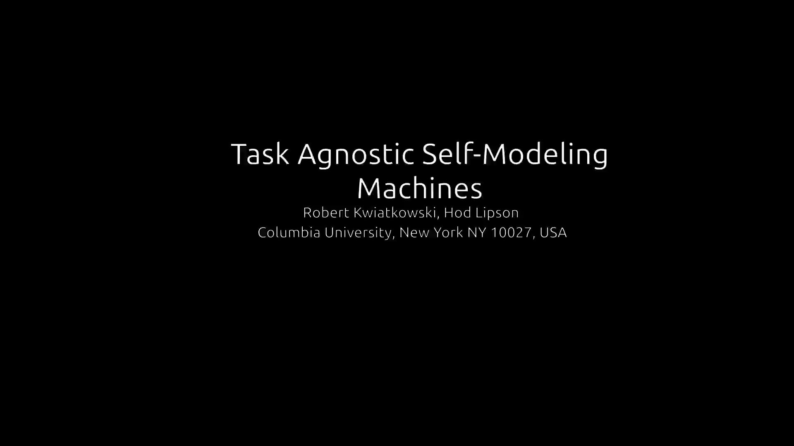
Notes:
Task-agnostic self-modeling machines

Slide 16
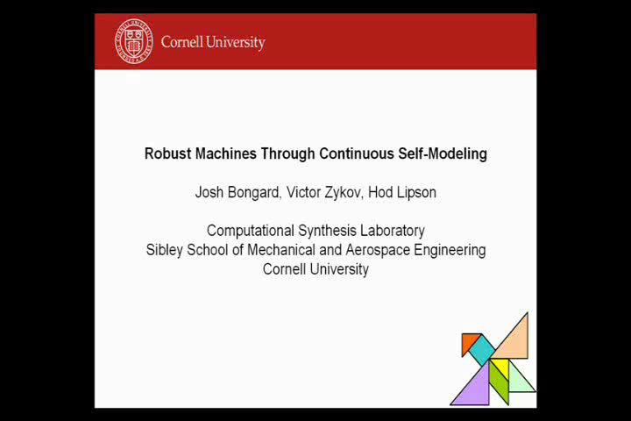
Notes:
Robust Machines Through Continuous Self-Modeling

Slide 17
Conclusions
Robots struggle with tasks humans do instinctively
But they’re getting better
Models tend to do better when the task is split up, but this requires human intervention
Simple reward functions can make rise to complex behaviors with sufficient learning

Slide 18
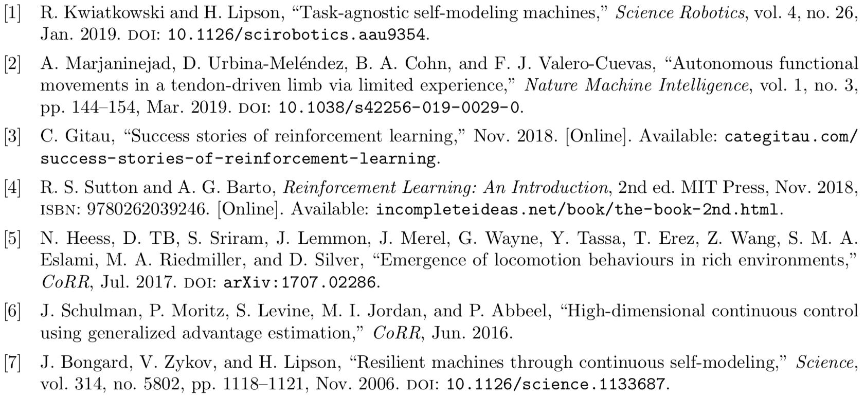
References

